Slide 1

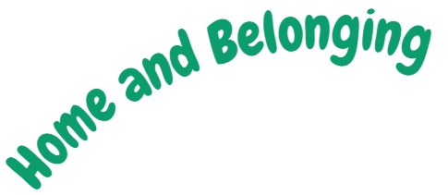

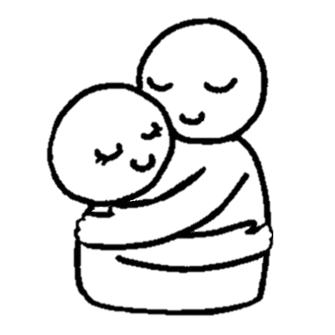
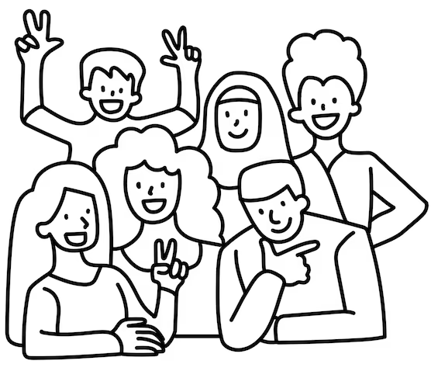
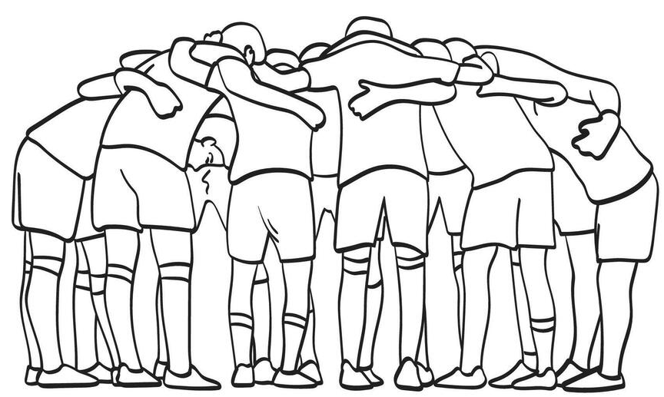
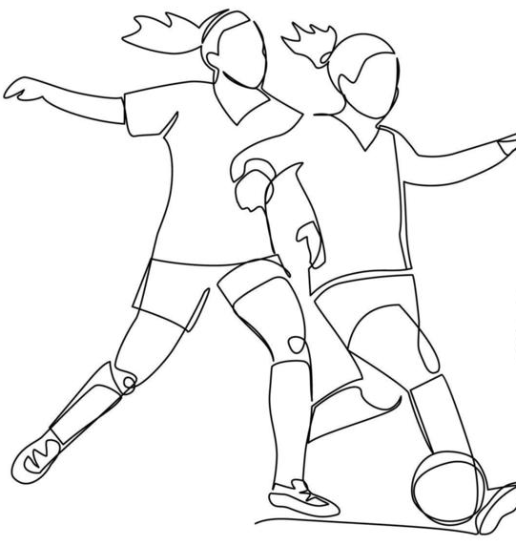


Slide 2
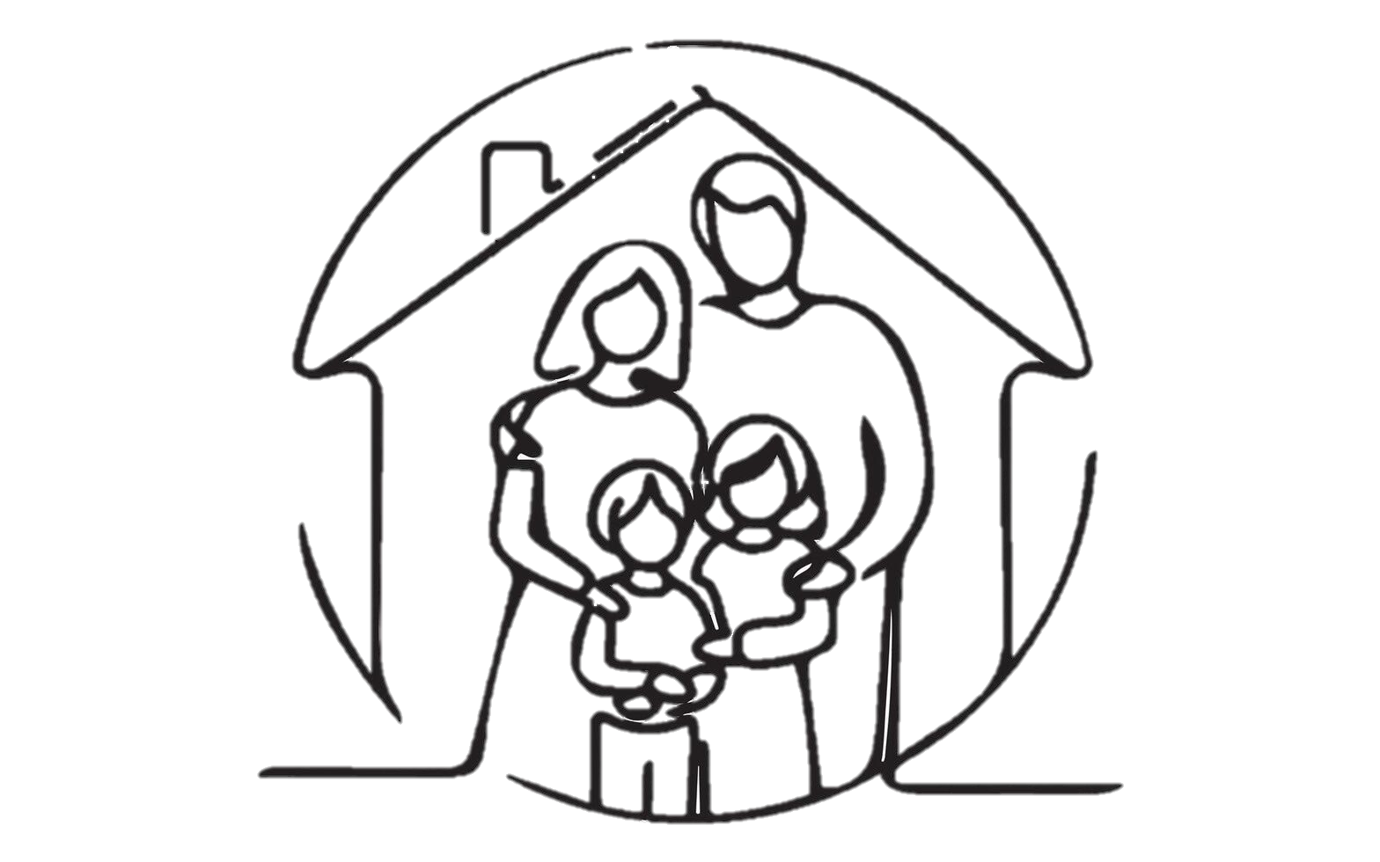



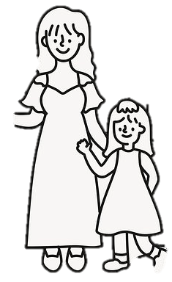
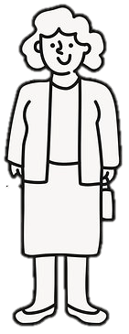
What does ‘belonging’ mean to you?
Think about where you can belong.
Notes:
Lead discussion task to try and get students to understand different ideas of ‘belonging’- examples might include belonging in school, at home, in the wider community, in a team/band/scouts or other group activity with peers.

Slide 3
Home
The home pictured has two parents, and two children- what is known as the traditional idea of a ‘nuclear’ family.
Do all homes have this structure?
Do all homes include children?
Do all homes feature families that live together in the same home?
Does your home look like this, or differ from this?
Notes:
Ask children to give ideas about who makes up a family. They could suggest other people who might make up a family, and some might suggest that a family has two mums, or just one parent and pets etc. Children do not have to share information about their own families, but this might help them to come up with their own ideas. The discussion should also lead in to families where parents are separated, and do not live in the same house, and consequently on to step-parents

Slide 4
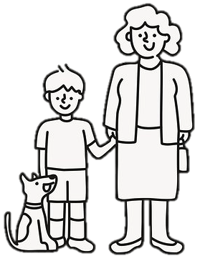
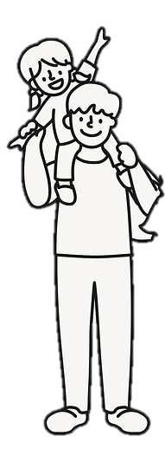
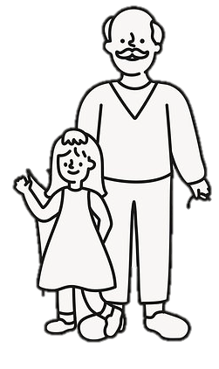
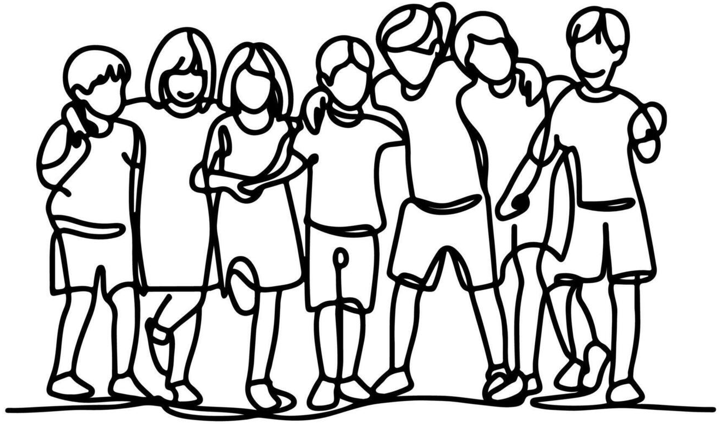
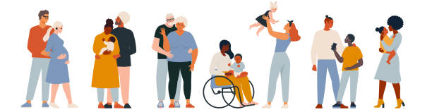
A home could be…
Or a grandma and her grandchildren, an uncle and his nephew, an adoptive parent and their children, two fathers and their daughter, a couple and their dog, a stepdad and his stepchildren…
A family can be whatever they want it to be!
Two mothers and their daughter
A mother and her son
A father and his daughter
A Grandad and his Granddaughter
Children who are looked after in a group home by people they aren’t related to.
Notes:
Talk children through different types of family, but make sure to emphasize that a family can include lots of different people, and might not look like the families on the board. You might wish to explain the term ‘children who are looked after,’ and make it clear that this could be in a residential home or a domestic home, and may not be biological relatives looking after them.

Slide 5
Adoption
Some children and young people are part of families who have adopted them.
Being adopted means a child legally becomes part of a new family, and the adopters become their legal parents, because the child was unable to be cared for by their birth family.
Most adopted people are though able to maintain some links with their birth family.
There are many different reasons why a child will be adopted, and there are many different reasons why adults may choose adoption as their route to parenthood.

Slide 6
Fostering
Some children and young people live with carers who they are not biologically related too, with either foster carers, or in residential homes.
Being fostered is sometimes for a short while, for other young people in can be until they reach adulthood. Most young people living in foster care are able to maintain a relationship with their birth family, even if they are not able to live with them.
Again, there are many different reasons while a child or young person will live with foster carers or in a residential home.

Slide 7
Special Guardianship
Some children and young people live with ‘special guardians’, these are not the biological parents, but are adults who are legally responsible for the young person.
They don’t become the legal parent to the young person, but they do care for them and can make decisions for them. Most young people living with special guardians are able to maintain a relationship with their birth family.
Again, there are many different reasons why a child or young person will live with special guardians.

Slide 8

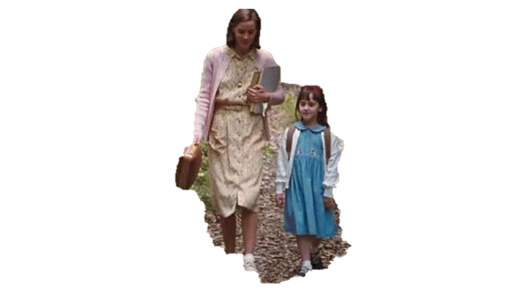



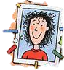
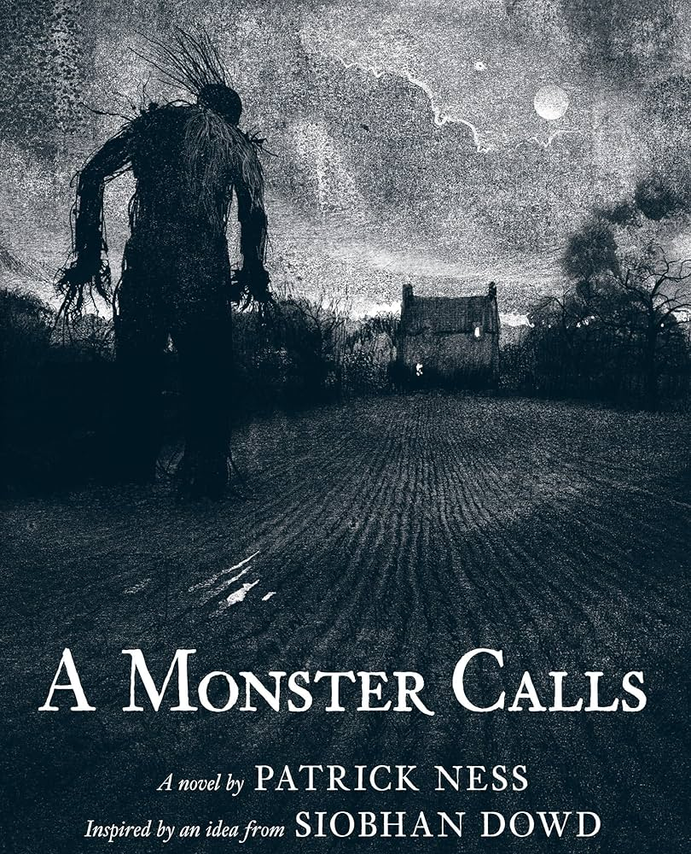
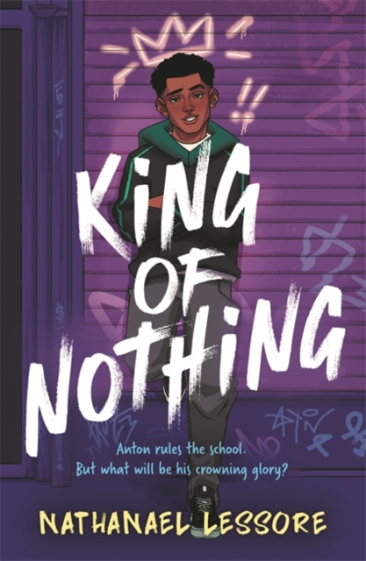





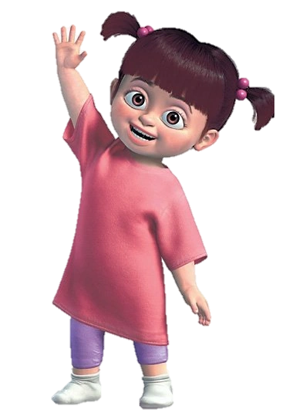
Can you think of any examples?
Have you ever read a book or watched something that makes you think about home or belonging? There are a few clues on the board to help you!
Notes:
Featured images: Several texts dealing with themes of peer pressure, love, community and exclusion that are commonly read in KS2-3. For wider media examples, Boo from Monsters Inc. and Stitch from Lilo and Stitch, which both deal with themes of family and finding community and safety in unexpected places.

Slide 9







What can we learn?
What can these examples teach us about home or belonging? Write down some ideas about these positive lessons, and what these ideas mean to you.
Notes:
Some suggestions: providing for people’s basic needs, supporting them within a wider community, shared struggle and solidarity etc.

Slide 10
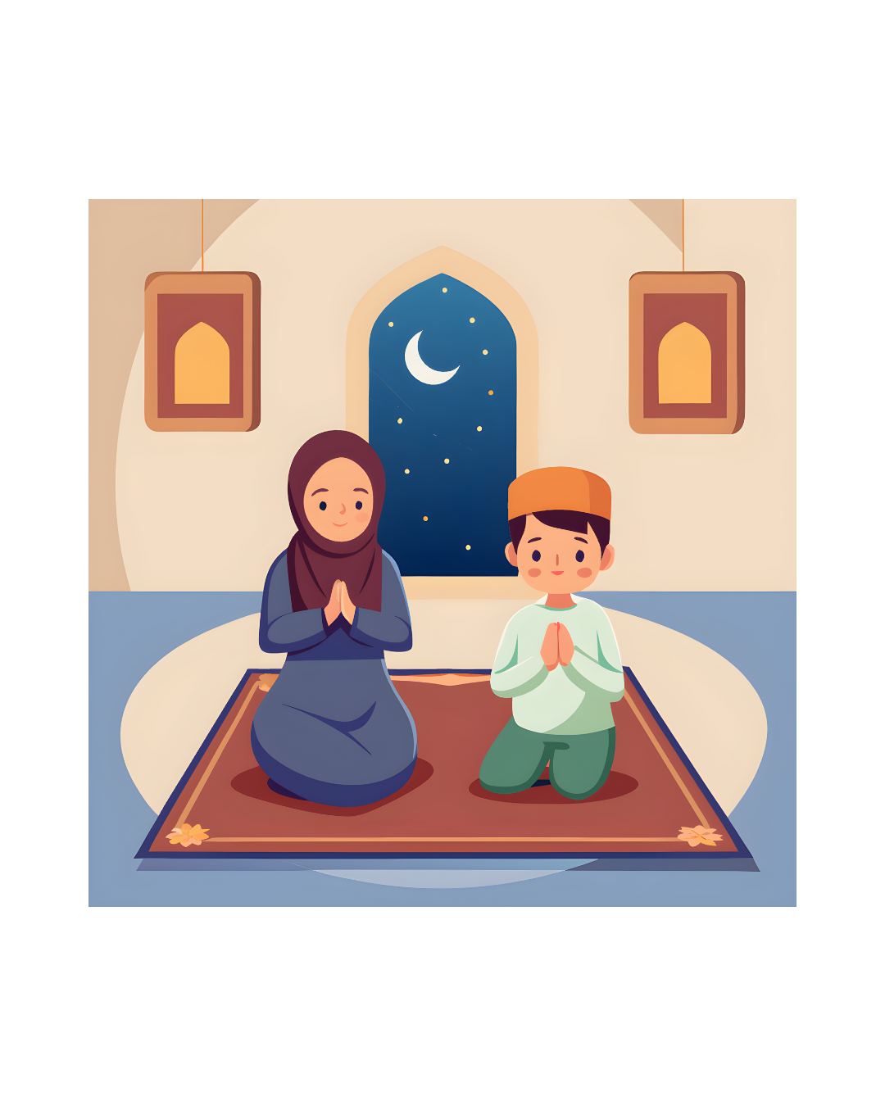
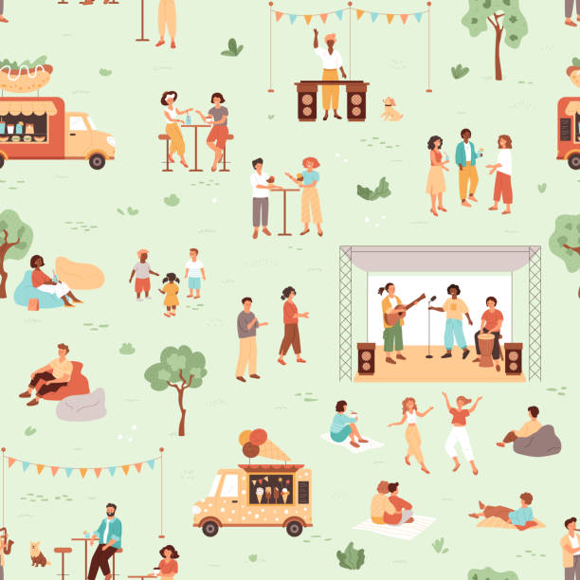
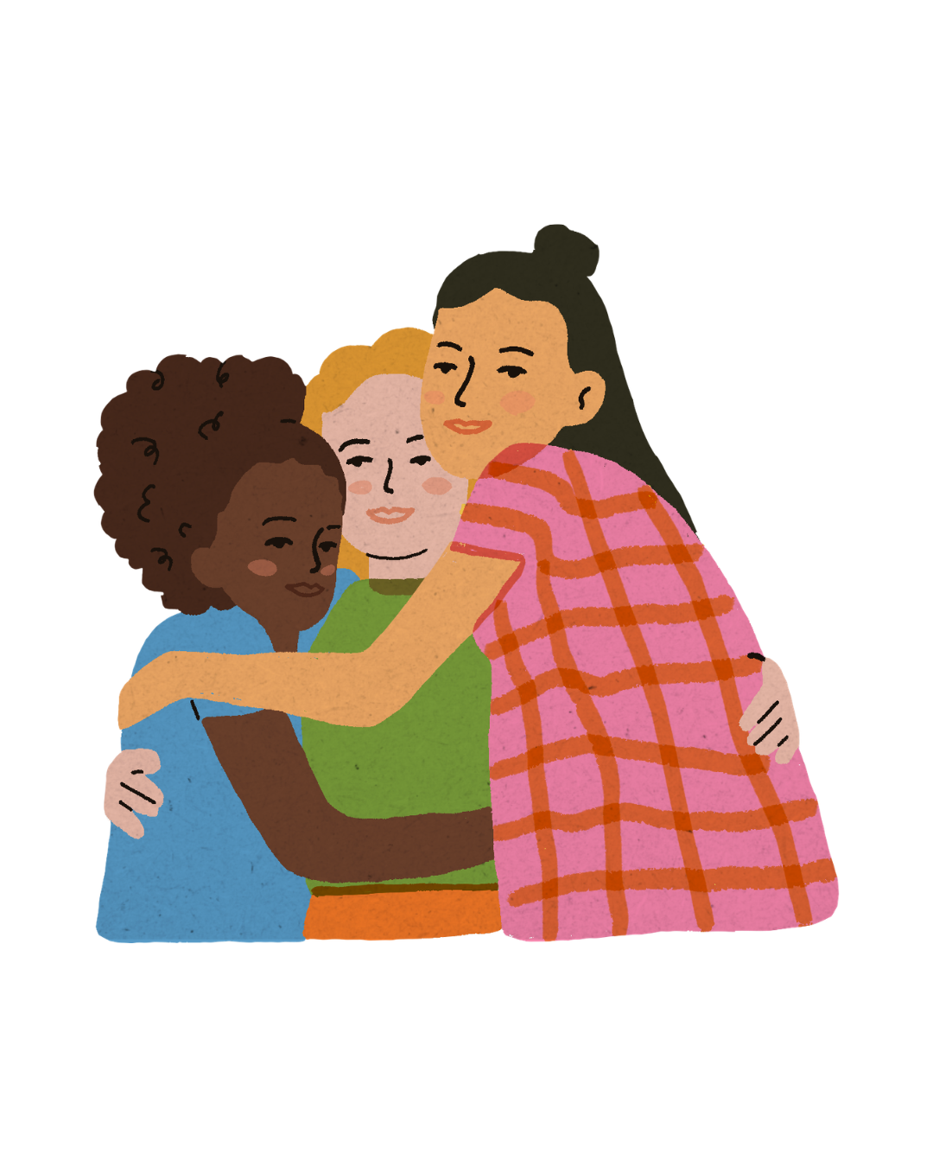
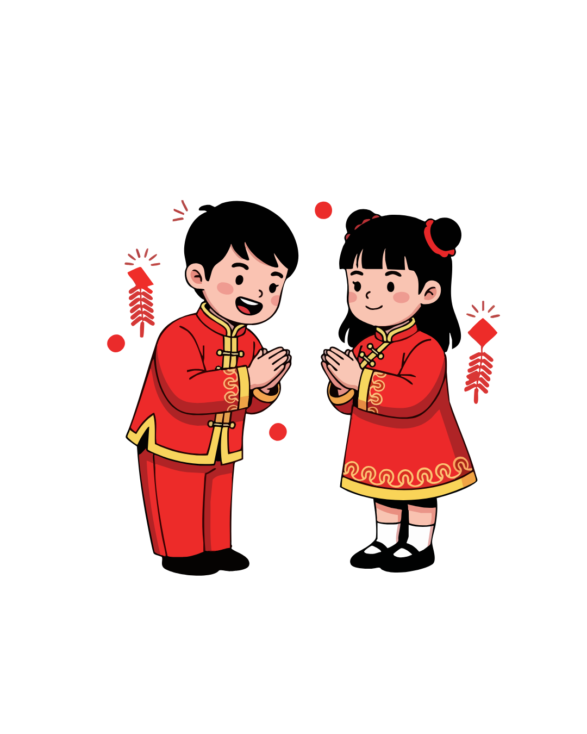
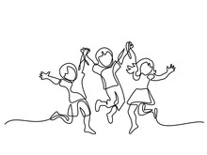
Let’s think about home and belonging
Where do you feel like you belong?
What does it mean to be part of a family?
Do you belong to anything outside of your house?
Are you in any clubs or groups that make you feel like you belong?
Notes:
Discussion around what home and belonging means to different individuals. This could cover a variety of different topics like sports clubs, religion, cultural identity, a sense of belonging with friends and with family.

Slide 11


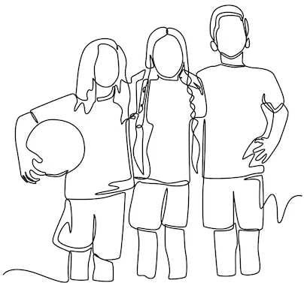
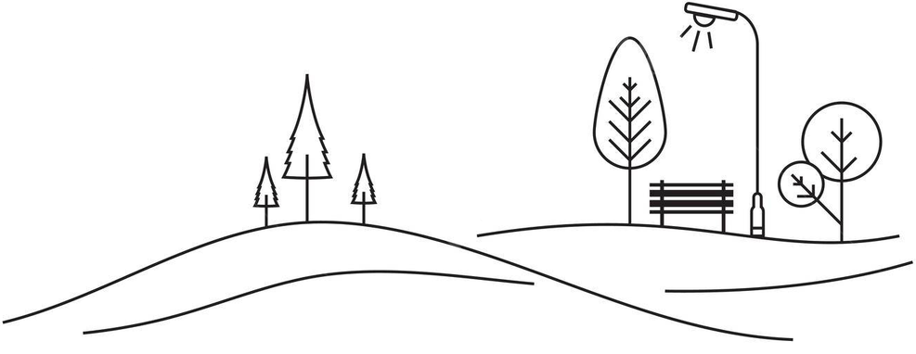
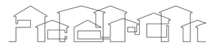
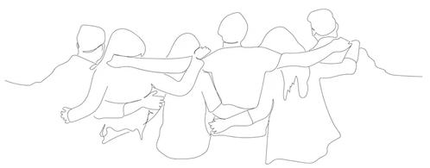
Belonging might mean…
Being supported and cared for at home
Belonging to a group, club or team
Feeling a part of your local community
Feeling safe and supported by friends
Being supported and feeling emotionally safe

Slide 12

What do you think about home and belonging?
You are going to write a short story or poem about what home or belonging means to you.
Think about what we have talked about today.
Your story or poem could be about a team, a group, a community or a home.
You can get some ideas from the next slide.

Slide 13
Ideas:
Stories:
A young person moves to a new area and they miss their old home. They join a sports team or local group and start to feel included.
A young person doesn’t feel safe in their home with their birth family. They are fostered, and whilst they find it different at first, they connect with their foster family and get adopted.
Someone who is usually quiet forms a band with their friends and they start performing gigs, finding a new sense of community and popularity.
Any more ideas to share?
Poems:
A poem called ‘Belonging’ that talks about what it means to belong and gives different examples and images.
An acrostic poem called ‘Home’ or ‘Belonging’ that talks about positive feelings of safety and comfort.
A narrative (story based) poem using one of the story ideas, that could include rhyming or other poetic features.
A poem dedicated to family, community or friends, and how they make you feel.
Any more ideas to share?

