Slide 1
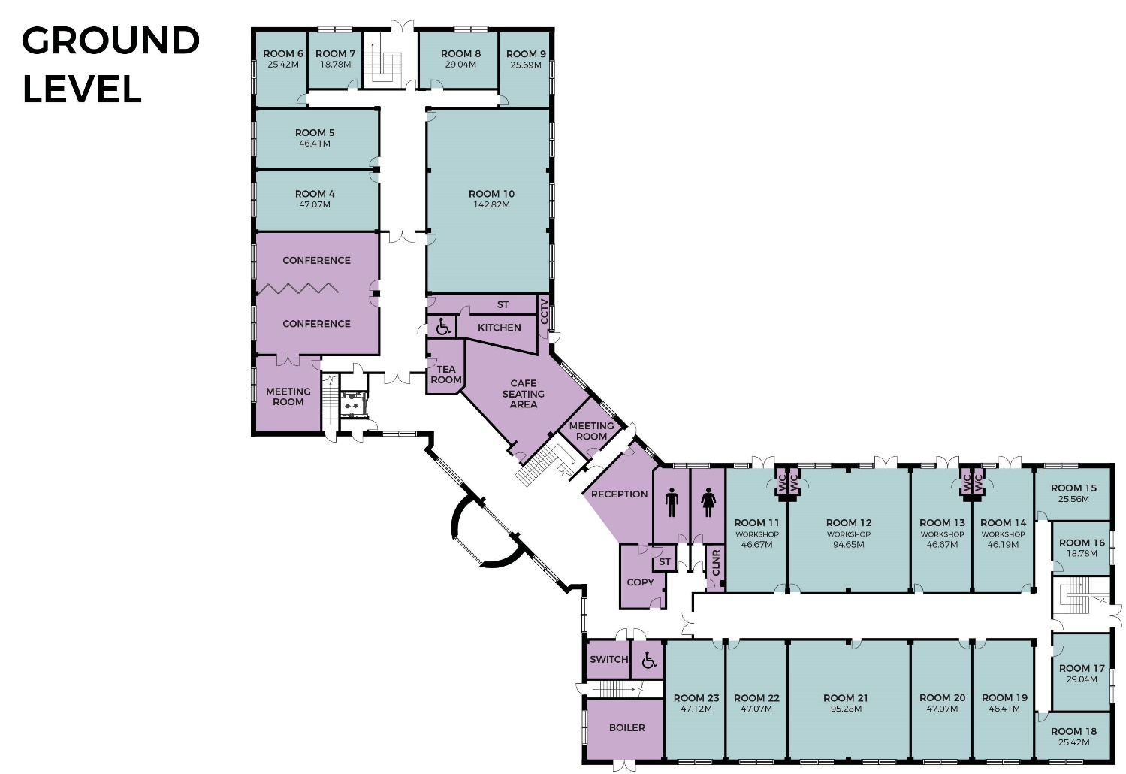
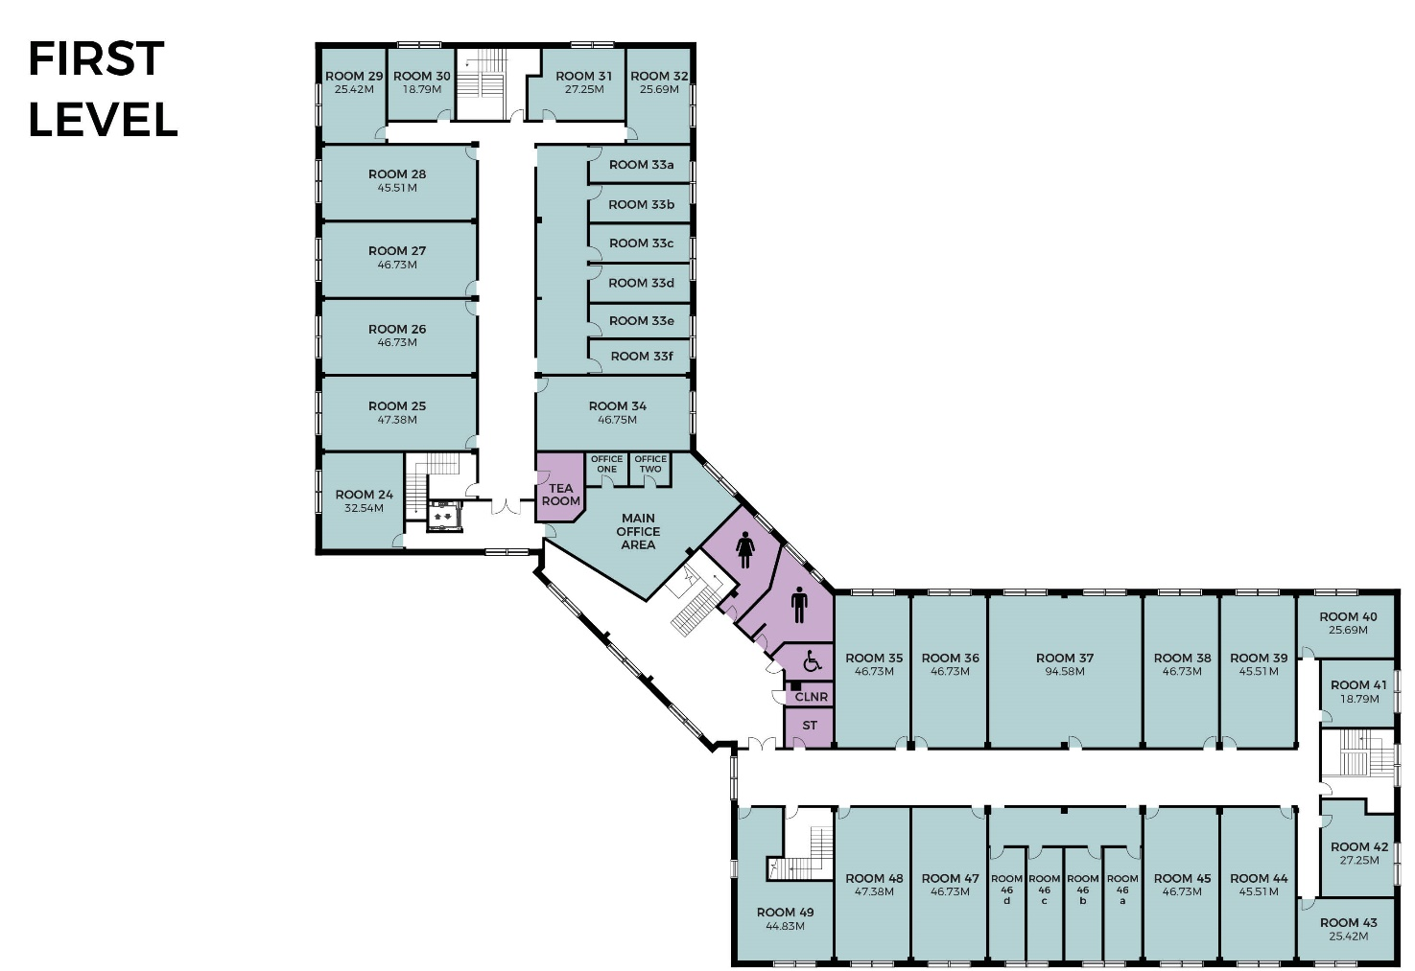
Current Office Space - Ground Level
7 – 200 Sqft – Coming Soon
8 – 312 Sqft – Available Now
23 – 505 Sqft – Available Now
Current Office Space - First Level
33e – 160 Sqft – Coming Soon
33f – 160 Sqft – Available Now
40 – 275 Sqft – Available Now
41 – 200 Sqft – Coming Soon
43 – 275 Sqft – Available Now
46a – 160 Sqft - Available Now
The Nest - 4 workstations – Available Now

